Slide 1


Project name: Pocket Diagnostics Team members: Rohan Bharadwaj, Donavan Burrow, Jacob Newlin, Elijah Rodriguez

Slide 2
Summary of Use
Problem statement:
Technicians in the electronics industry have evolved to servicing customers directly for consumer products, similarly to a plumber or electrician. Often they cannot bring or access bench devices and a suitable substitute is required to complete a job in a timely manner.

Slide 3
Project description
Solution proposal:
Develop a small battery-powered instrument that connects to a smartphone that performs the function of the following bench instruments:
Serial Port Sniffer (RS-232, 485, TTL)
I2C Inspection & SPI Inspection
16-channel Logic Analyzer
GPIO Interface, Signal Inspector (simple low-frequency O-Scope).

Slide 4
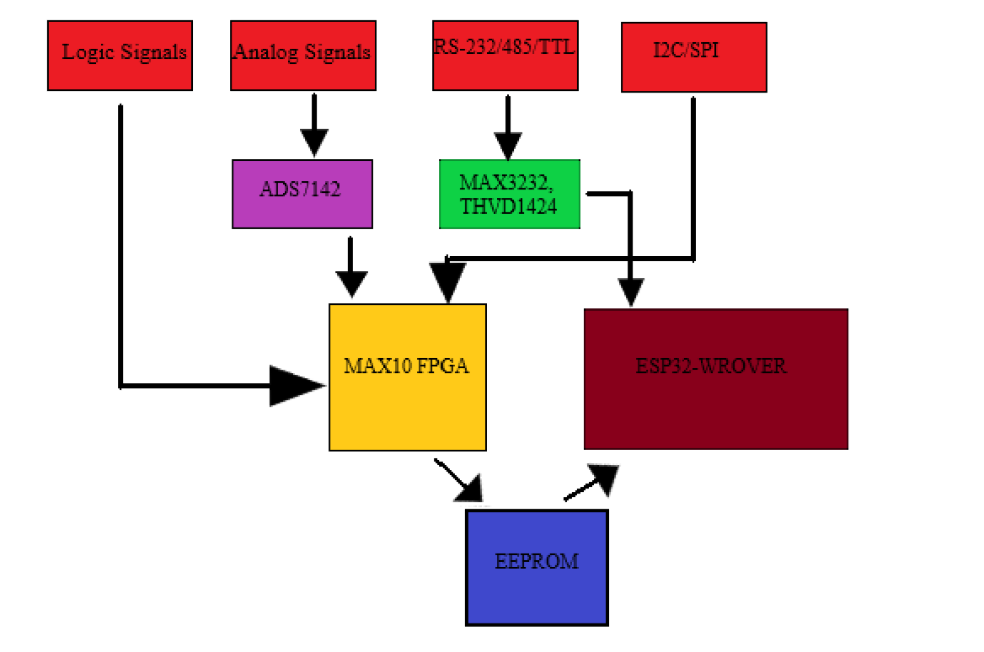
Diagram of subsystems and interface

Slide 5
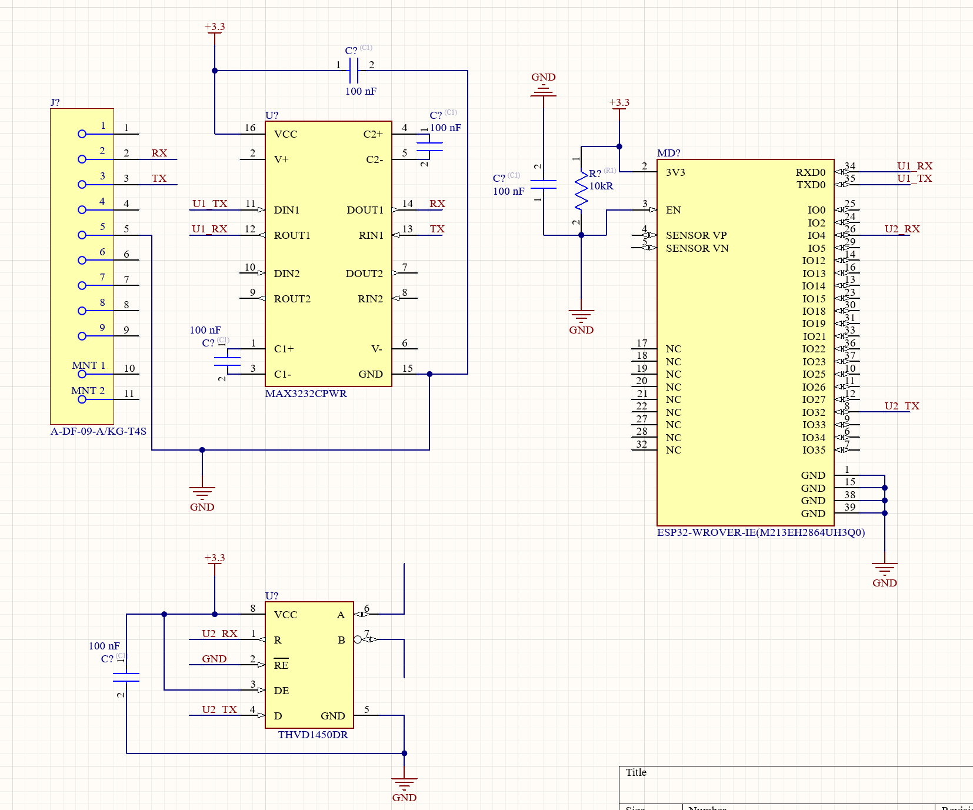
Data Collection
Elijah Rodriguez
Accomplishments since the last presentation <10> hrs | Ongoing progress/problems and plans until the next presentation
Completed introductory subsystem project Created schematic for serial port sniffer connected to the ESP32 | Collaborate with Rohan regarding PCB design for I2C and SPI PCB design for serial port sniffer PCB design for the ESP32

Slide 6
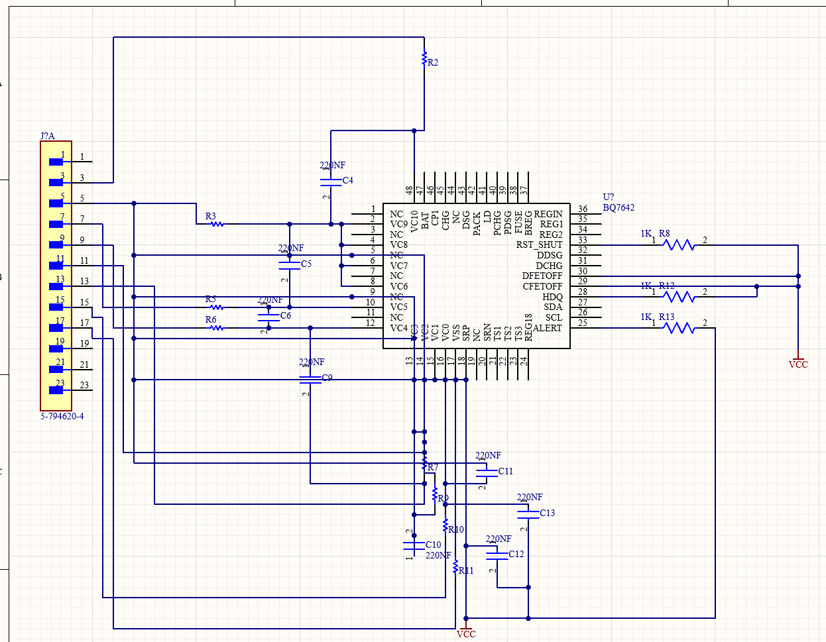
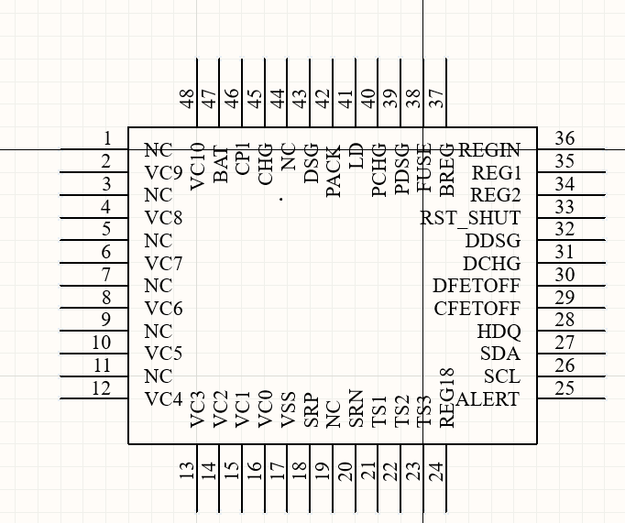
Power and Data Processing
Rohan Bharadwaj
Accomplishments since the last presentation <10> hrs | Ongoing progress/problems and plans until the next presentation
Completed introductory subsystem project. Created symbol, footprint, and schematic for battery management IC. | PCB routing for battery management IC. PCB design for FPGA I2C and SPI for FPGA GPIO interface for FPGA

Slide 7
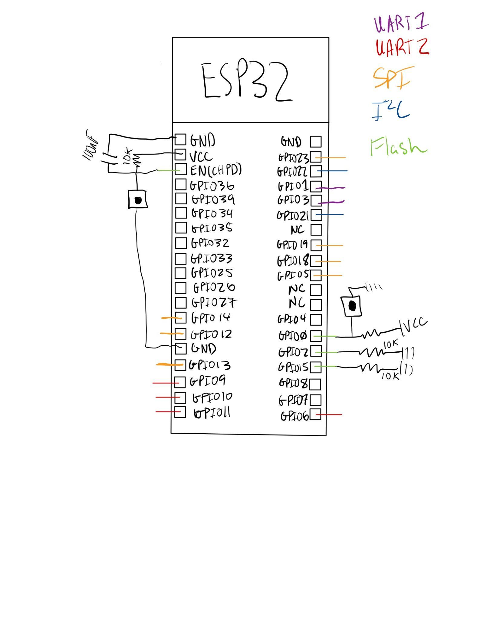
Data Transfer
Jacob Newlin
Accomplishments since the last presentation <10> hrs | Ongoing progress/problems and plans until the next presentation
Completed GPIO interface of ESP32 Built and Demonstrated Subsystem Project Begun work on ESP32 code for data acquisition | PCB design for ESP32 and memory Finishing code for data acquisition Testing ESP32 code with SPI/I2C signals Coding FPGA for data acquisition and transfer to ESP32 Coding bluetooth transfer with the phone

Slide 8
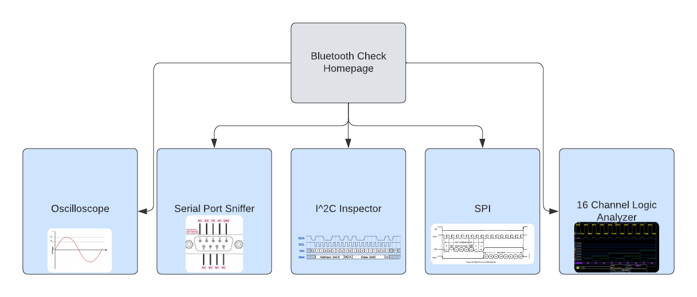
App Design
Donavan Burrow
Accomplishments since the last presentation <10> hrs | Ongoing progress/problems and plans until the next presentation
Exported Flutterflow Project into a Flutter Project Created Basic UI layout of App | Bluetooth Implementation and testing communication to ESP32 Oscilloscope PCB Implementation

Slide 9
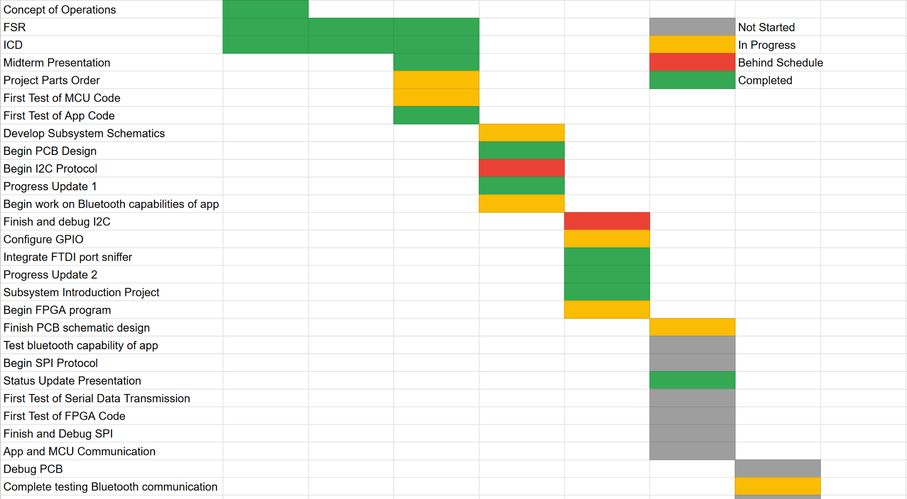
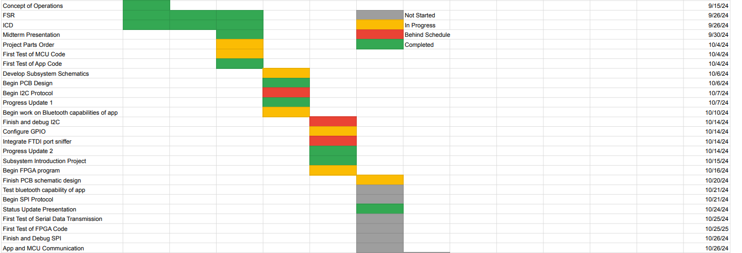
Execution plan

Slide 10
Validation plan
Task | Specification | Result | Owner
Power Consumption | 4.5 W |  | Rohan
Rechargeable Li-ion battery power supply | 4.5 W for 2 hours |  | Rohan
Input Voltage Level | 3.3 V |  | Rohan
FPGA Signal Processing | Check that signal is processed |  | Rohan
FPGA Logic Analyzer Functionality | Check that captured signal is analyzed by the FPGA |  | Rohan
FPGA and Microcontroller TTL Communication | Data Rate: 8 Mbps |  | Rohan, Jacob
FPGA and ADC Communication | SPI Clock Frequency: < 1 MHz |  | Rohan, Elijah
FPGA SPI Protocol Validation | < 1 MHz |  | Rohan, Jacob

Slide 11
Validation plan
Task | Specification | Result | Owner
FPGA I2C Validation | < 1 MHz |  | Rohan, Jacob
Oscilloscope Validation | 10kHz <= |  | Donavan
Oscilloscope Resolution Test | ~0.9mV step |  | Donavan
App Bluetooth Communication | High/Low bit change via switch |  | Donavan
I2C Verification | < 1 MHz |  | Jacob
SPI Verification | < 1 MHz |  | Jacob
MCU Check | Make sure data is processed properly |  | Jacob

Slide 12
Validation plan
Task | Specification | Result | Owner
MAX3232CPWR Verification | <= 3.3V |  | Elijah
THVD1424RGTR Verification | <= 3.3V |  | Elijah
Data Transmission | Data rates: <=115200 bps for RS-232 >= 1 Mbps for RS-485 |  | Elijah
Data Formatting | Received data matches the transmitted data with a 0% error |  | Elijah

